Slide 1

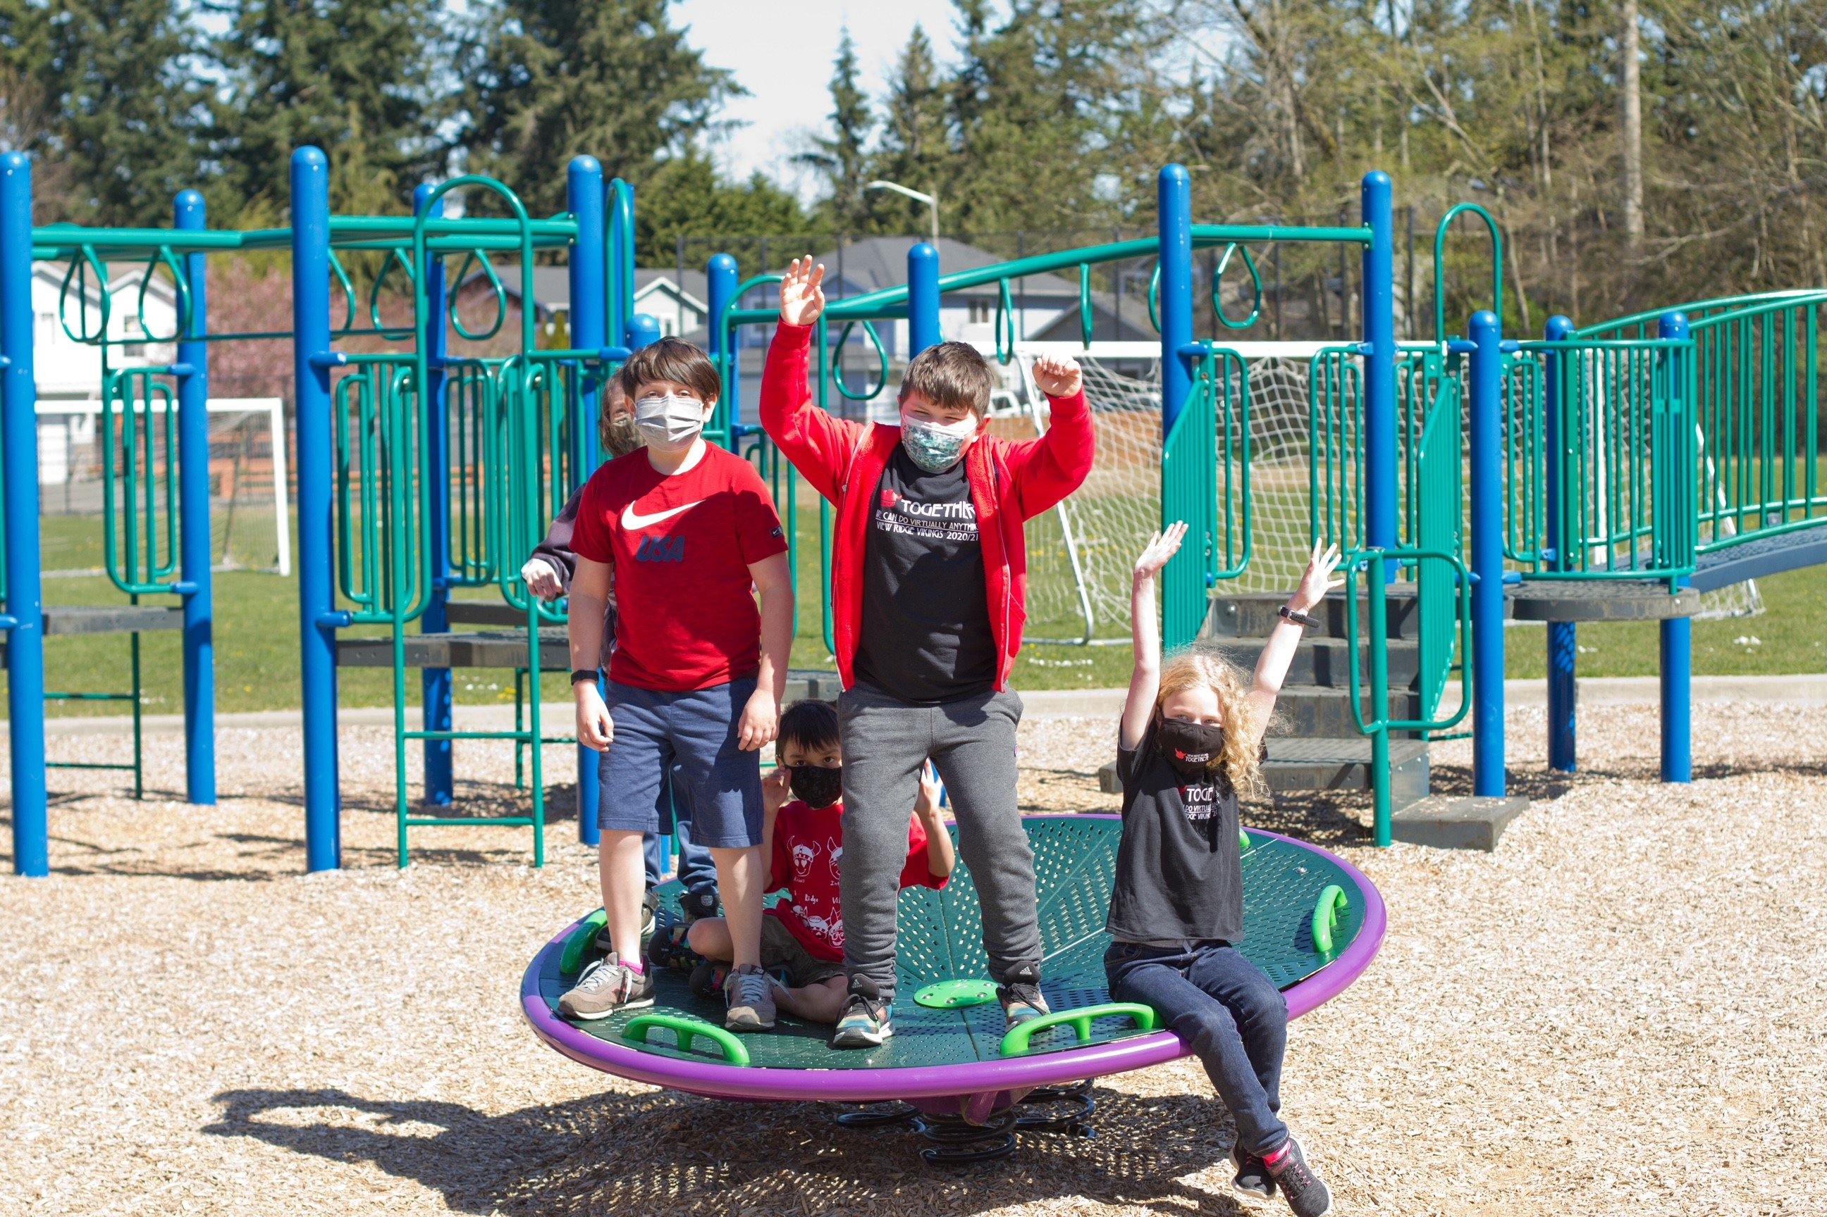


Welcome to
Everett Public Schools

Slide 2

DID YOU KNOW?
How many of these facts do you know?

Slide 3

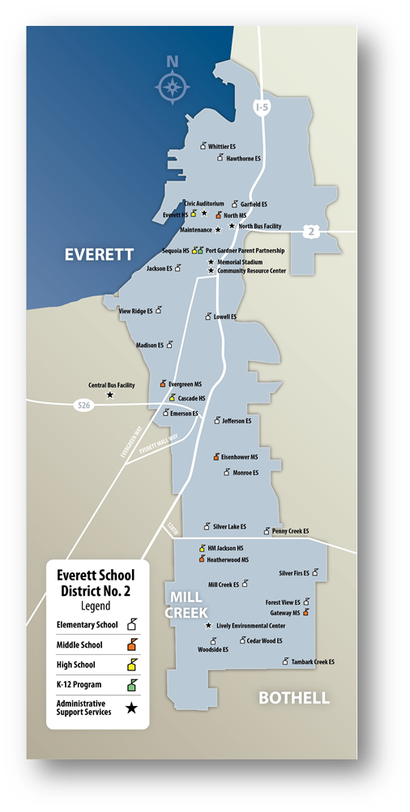
We are one of the fastest growing districts in the county
More than 20,000 students now, 1,858 more expected by 2026

Slide 4
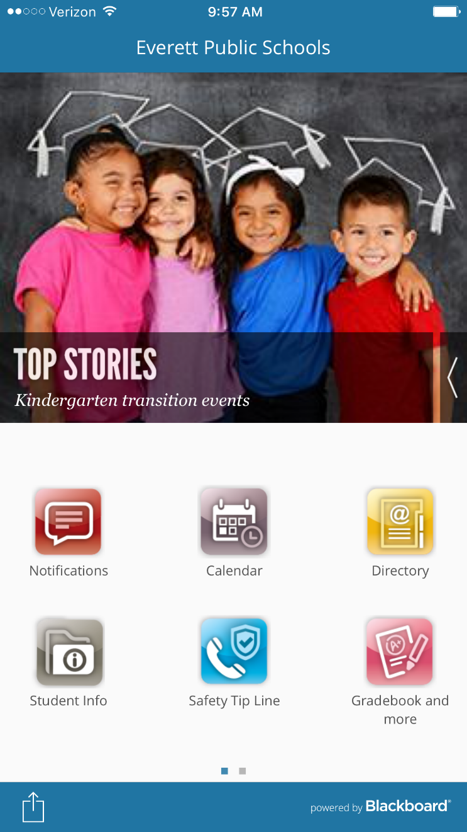


We have an app!
Search for Everett Public Schools in your app store.

Slide 5

Everett Public Schools is diverse!
More than 90 languages are spoken by students in Everett Public Schools

Slide 6



More than 40% of EPS students live in poverty
We served 1,012 homeless students last year – enough to fill over 2 elementary schools

Slide 7
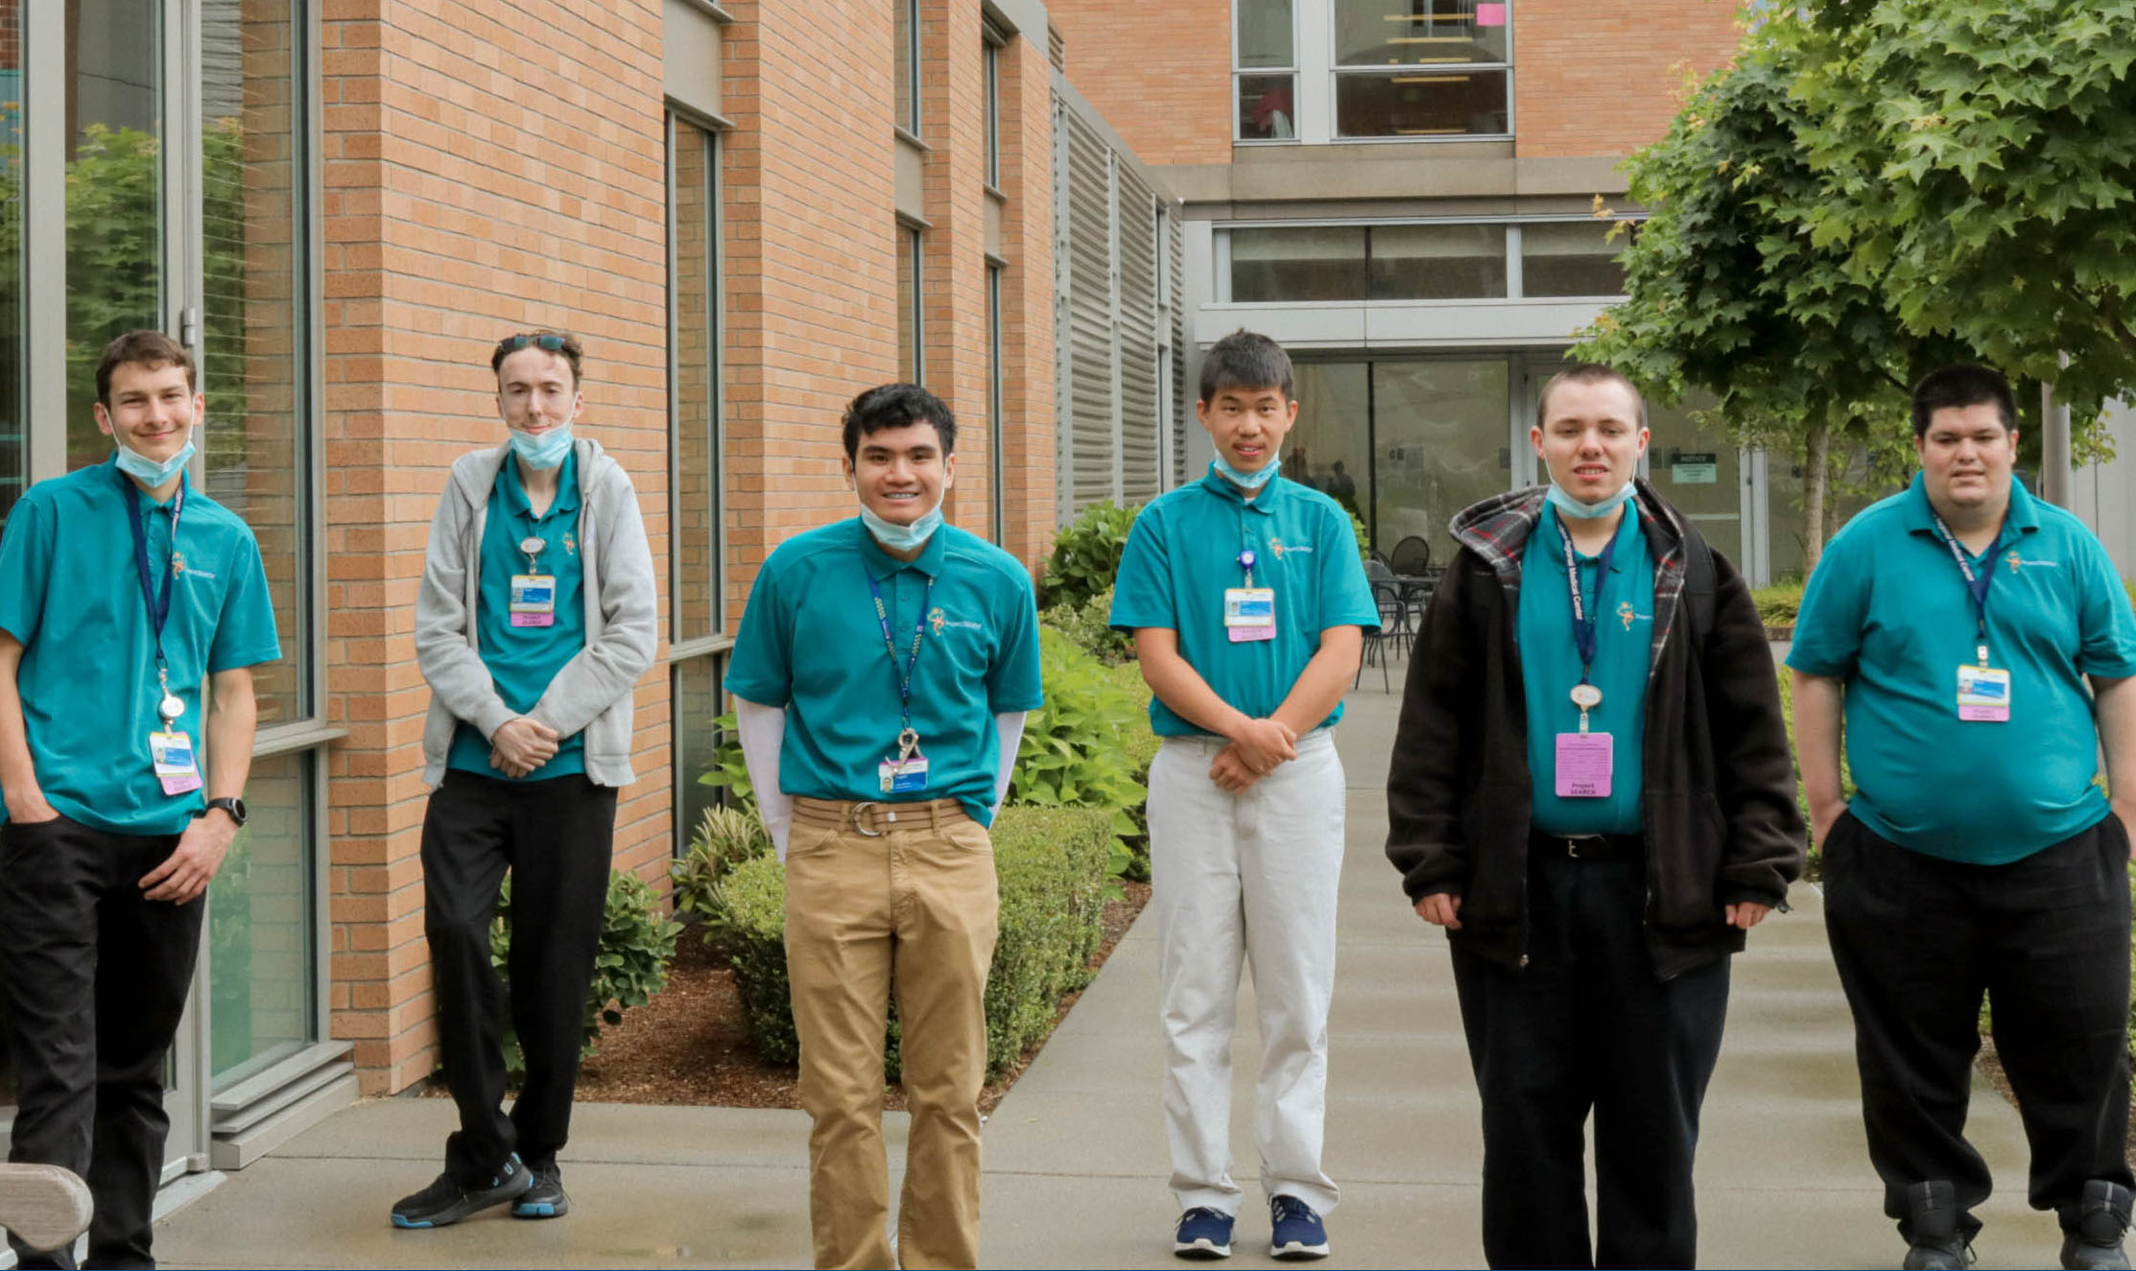
17% of students in our district are students with disabilities
About 13% of students with disabilities have IEPs and 4% have 504s.

Slide 8
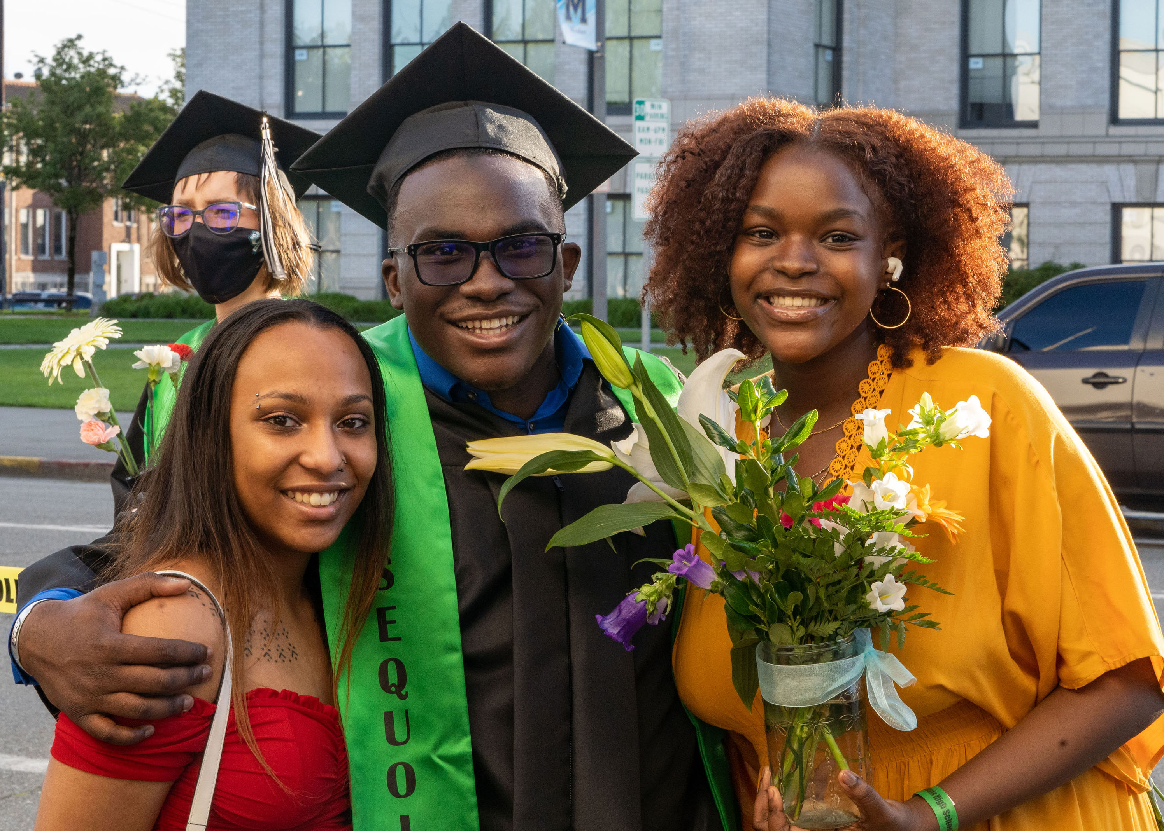
Everett Public Schools has one of the highest graduation rates in the state!*
95% graduate in four years
*In Washington State, 83% of students graduate in four years

Slide 9
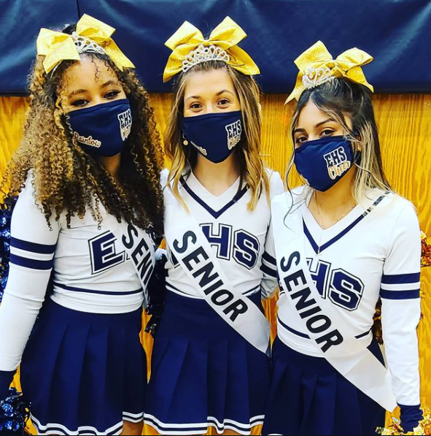
District residents aged 60+ are eligible for free admission to some school sporting and performance events.
Call 425-385-4041 or see our website information on Senior PEP Club!

Slide 10
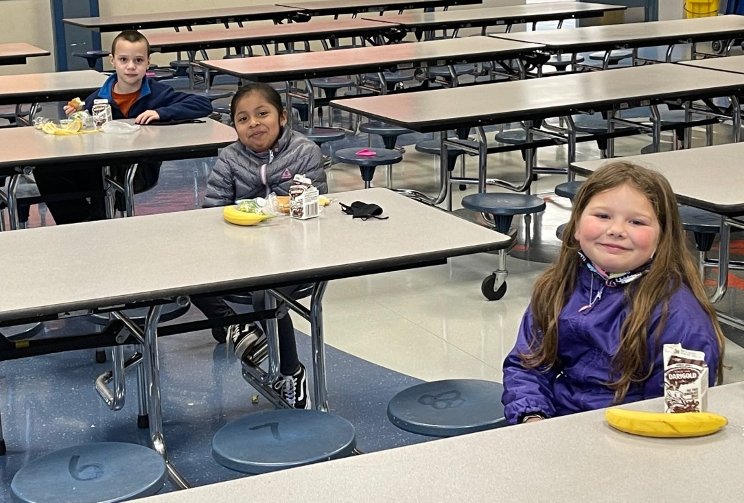
During the 2020-21 school year more than 1.9 million meals were served!
All meals were free to students through a USDA waiver*
*All meals are also free for 2021-22!

Slide 11
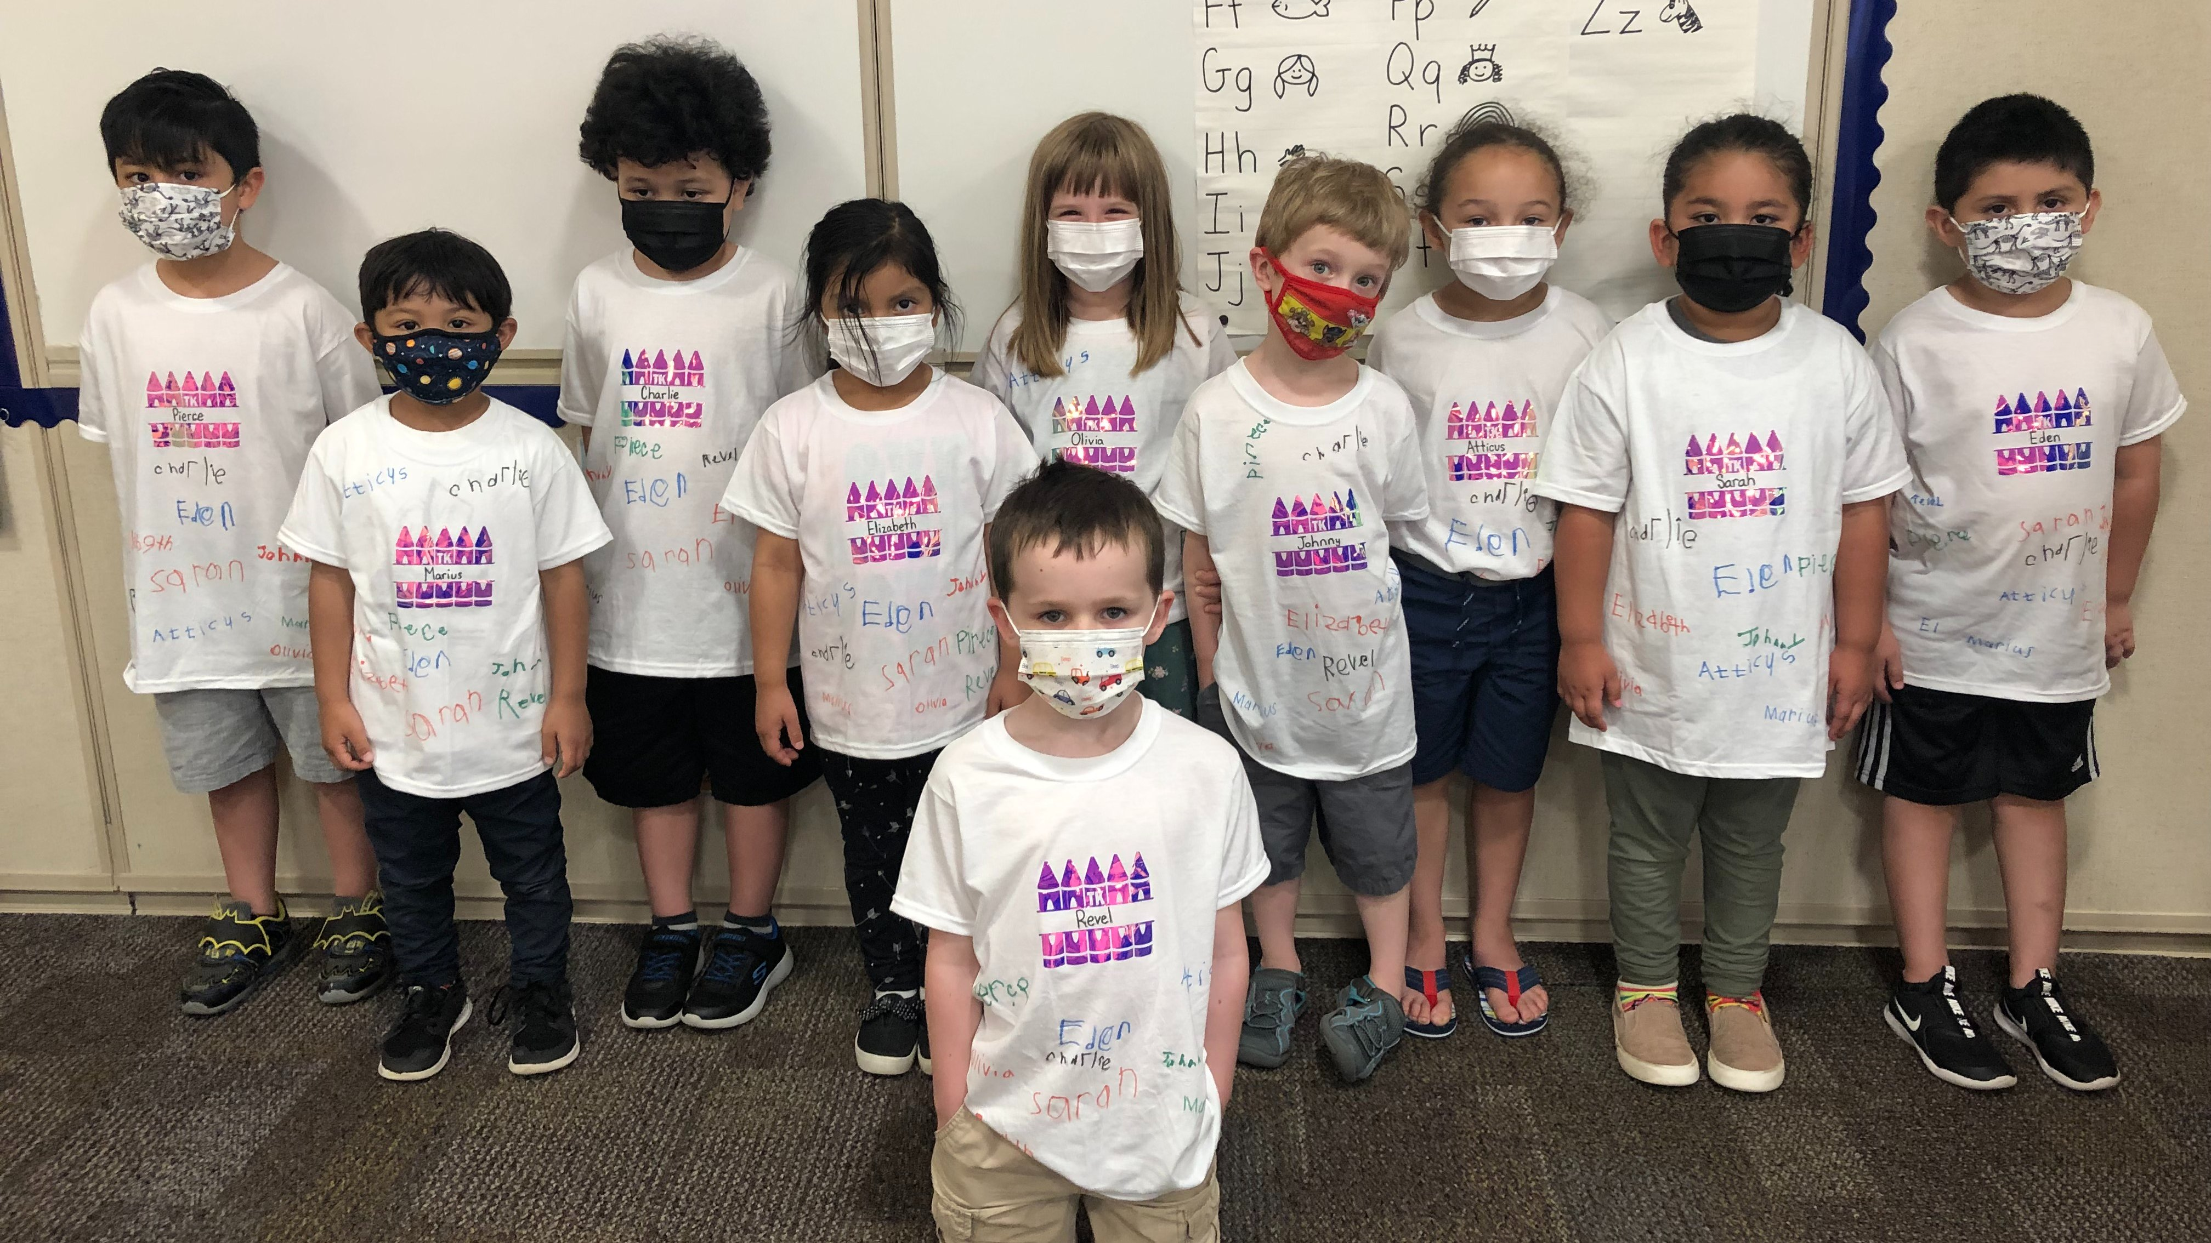
In the summer of 2021, more than 4,000 students experienced summer school.
Includes Everett Ready and Jump Start

Slide 12
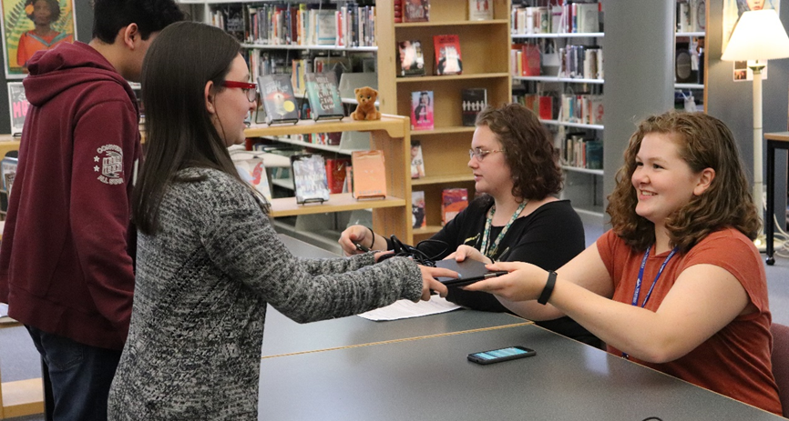
We are a 1:1 district – all students have access to a technology device
Thanks to voters and the 2016 bond

Slide 13

Every school has a robotics program

Slide 14
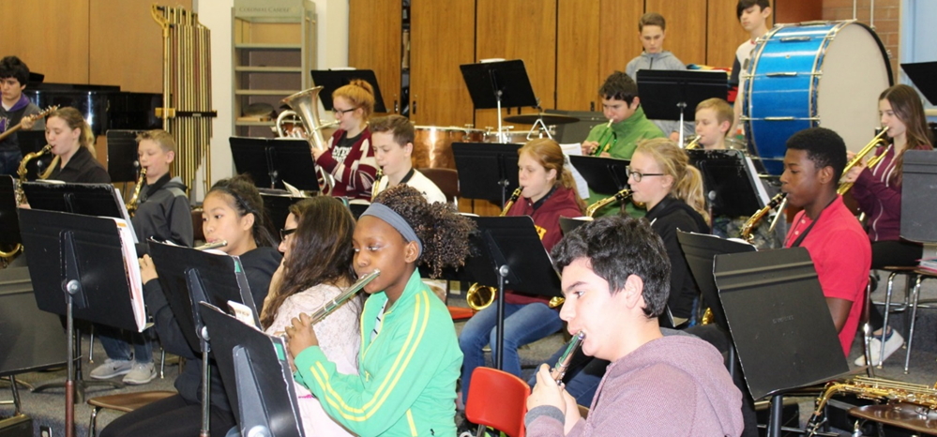
We partner with Music4Life to put gently-used music instruments into the hands of students in district music programs.

Slide 15
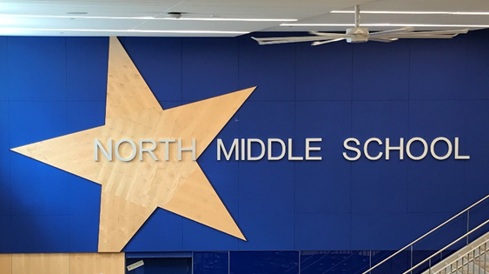
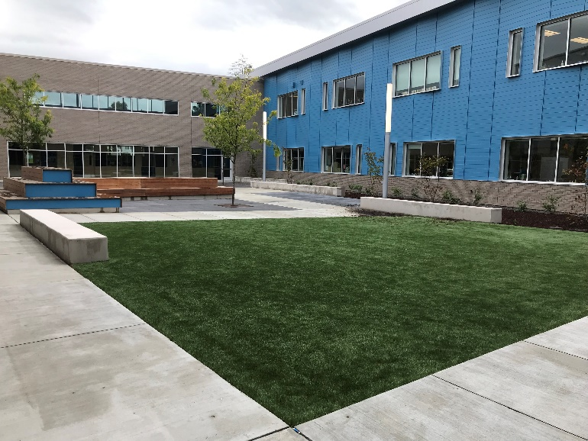
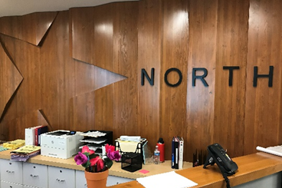
The modernized North Middle School opened to students in fall 2020
Thanks to voters and the 2016 bond

Slide 16
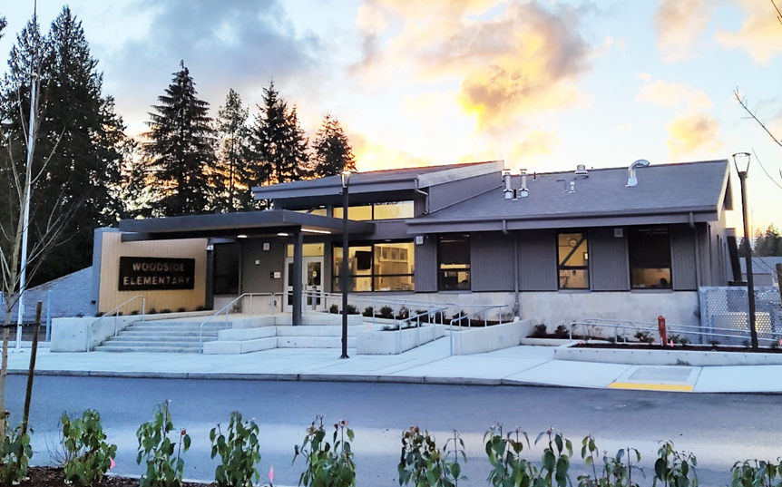
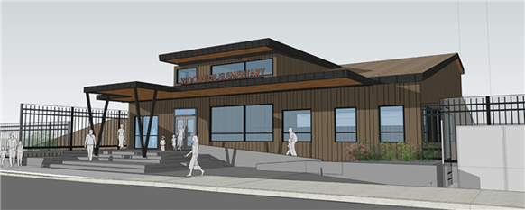
The modernized Woodside Elementary opened to students in fall 2021
Thanks to voters and the 2016 bond

Slide 17
Everett Public Schools has a refreshed strategic plan. This ambitious, exciting and comprehensive effort will guide Everett Public Schools for the next five years and aims to bring everyone together to meet the needs of all students.

Slide 18

STRATEGIC PLAN 2021-26
MISSION
To inspire, educate, and prepare each student to achieve to high standards, contribute to our community, and thrive in a global society.
Core Values

Slide 19
STRATEGIC PLAN 2021-26
VISION
Our students will lead and shape the future.
They will be well-rounded, healthy, and flexible thinkers with a global perspective who can access resources and collaborate.
They will demonstrate empathy, pride, and advocacy for self, school, and community while respecting the diversity and worth of others.
They will acquire the knowledge, attitudes and skills to adapt to the emerging needs of a changing world.

Slide 20
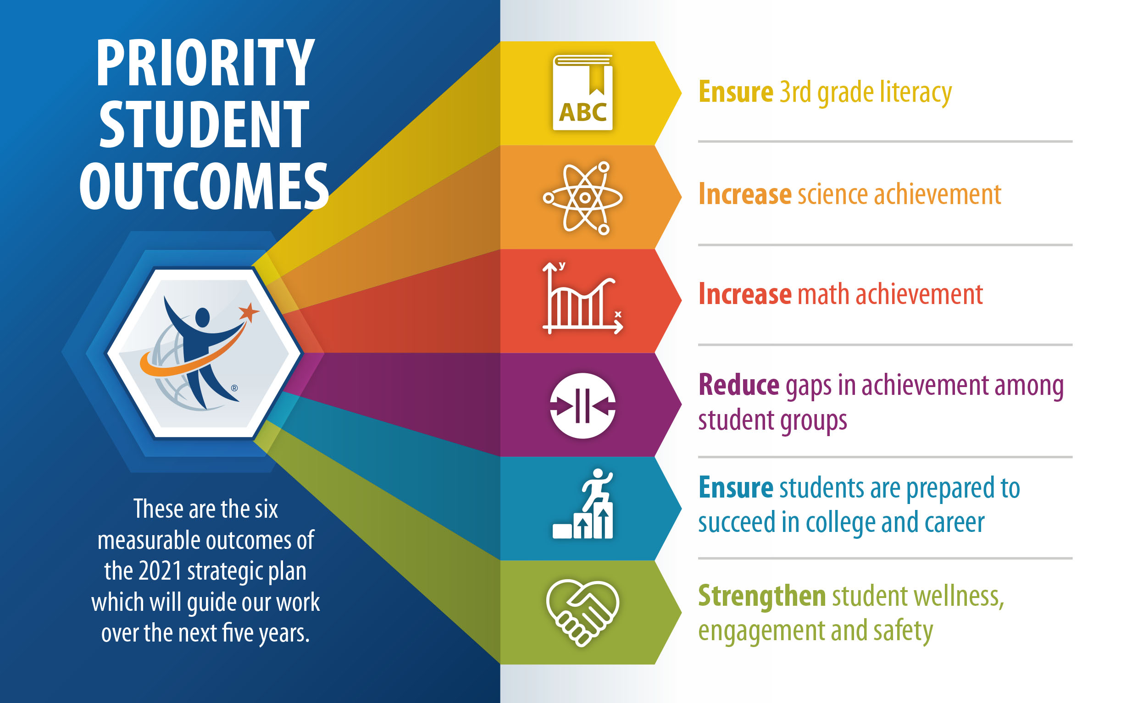
STRATEGIC PLAN 2021-26
Priority Student Outcomes

Slide 21
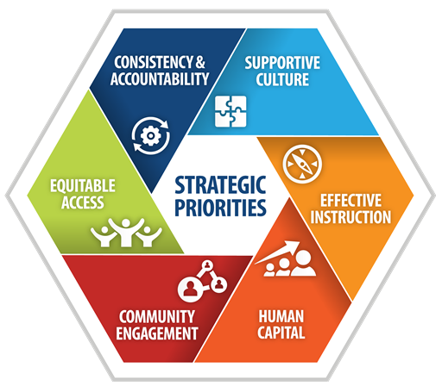
STRATEGIC PLAN 2021-26
Strategic Themes
The Priority Student Outcomes will be achieved through six strategic themes

Slide 22
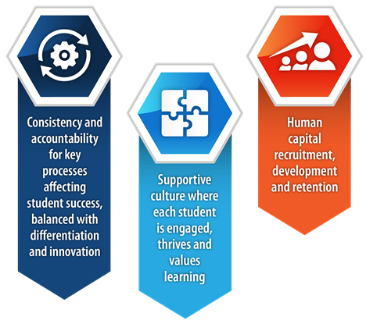
STRATEGIC PLAN 2021-26
Initiatives
Each Strategic Theme has initiatives created for the first year of the strategic plan. These 2021-22 initiatives will help meet the theme goals which will ultimately help us achieve our Priority Student Outcomes.

Slide 23
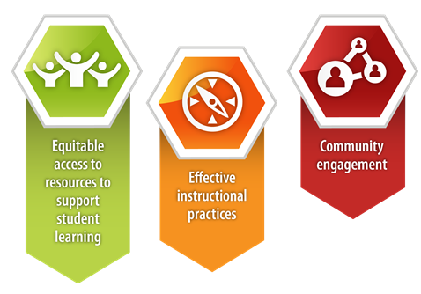
STRATEGIC PLAN 2021-26
Initiatives
Each initiative is assigned a sponsor, an owner and team members.
Follow Strategic Plan progress here
https://www.everettsd.org/StrategicPlan

Slide 24
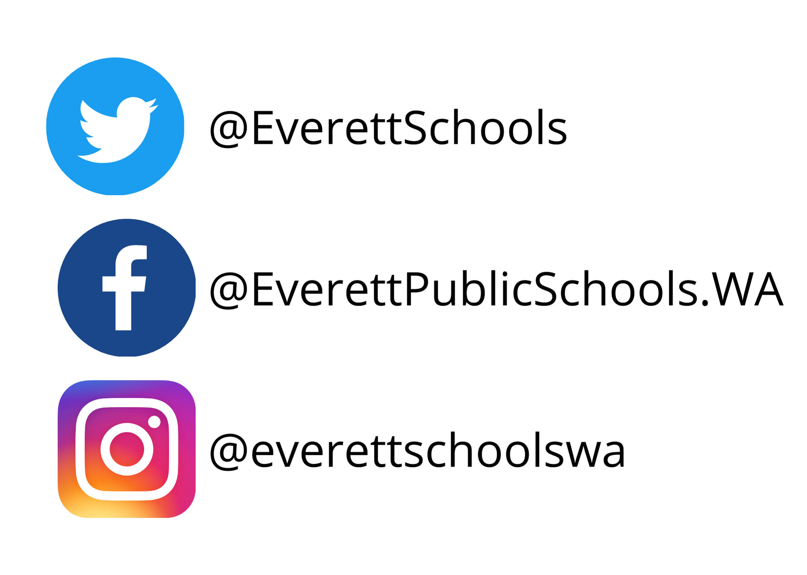
Follow us on social media!

Slide 25
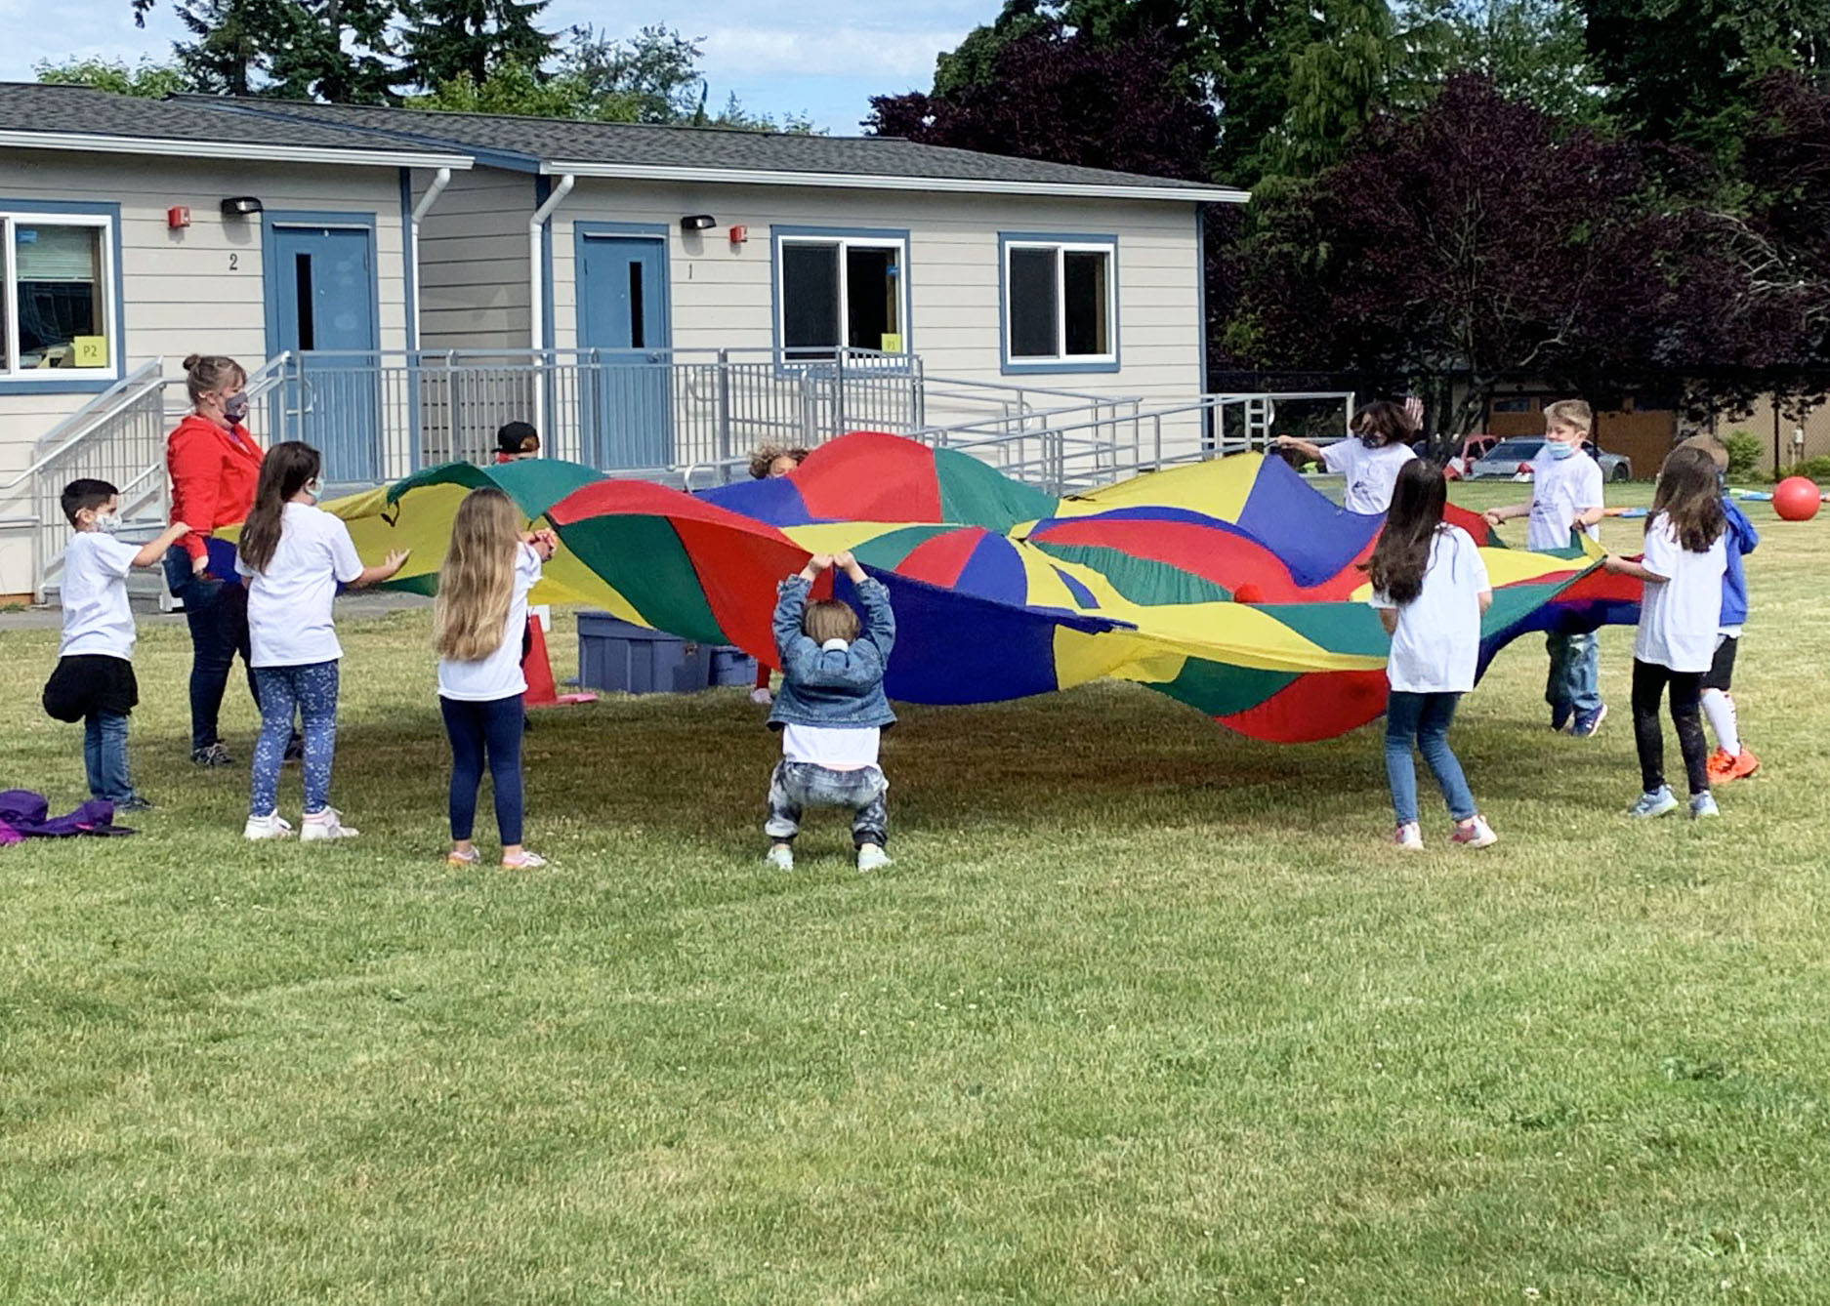
We learn, grow and laugh, together!

Slide 26
INSERT A FACT ABOUT YOUR SCHOOL (and/or photo(s)
Add relevant text and information as needed

